Slide 1
IoT • TINYML • EDGE AI
Energy-Efficient
TinyML-Based IoT System
for Real-Time Condition
Monitoring
SENSORS → ESP32
EDGE CLASSIFICATION
ESP32 • Vibration + Temperature • On-device monitoring
LEDs • OLED • BUZZER
PROJECT TEAM
P. Uday — 2520090089
A. Sri Chaitanya — 2520090094
Dharshan — 2520090088
Mrudula — 2520090073
Real-time condition monitoring

Slide 2
Project Overview
Monitors vibration and environmental temperature/humidity.
ESP32 reads sensors and classifies the condition as Normal, Warning, or Abnormal.
OLED shows readings; LEDs and buzzer provide local alerts.
Designed for compact, low-cost, edge-based monitoring.

Slide 3
Problem Statement & Objectives
Unexpected vibration or overheating can indicate equipment problems.
Provide continuous, near-real-time condition monitoring.
Give clear visual and audible alerts when limits are exceeded.
Reduce dependence on cloud processing by handling decisions on the ESP32.

Slide 4
Hardware Components
ESP32 DevKit V1 — main controller.
MPU6050 — accelerometer/gyroscope for motion and vibration.
DHT22 — temperature and humidity sensor.
0.96-inch I²C OLED — displays readings and status.
Green / Blue / Red LEDs, buzzer, push button, resistors, breadboard, jumper wires.

Slide 5
System Architecture
Sensor data is processed locally on the ESP32.
MPU6050 + DHT22
→
ESP32 Sampling
→
Threshold Decision
→
OLED + LEDs + Buzzer
Sampling interval: 500 ms
Classification in the supplied code uses vibration thresholds.

Slide 6
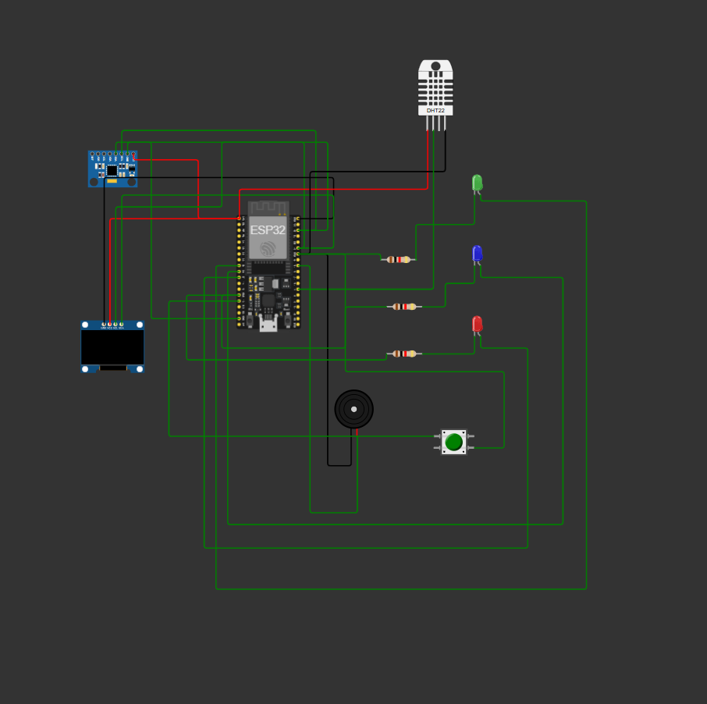
Circuit Wiring Diagram
ESP32 connections to MPU6050, DHT22, OLED, indicators and button.

Slide 7
Key Pin Connections
I²C bus: SDA GPIO 21, SCL GPIO 22 (MPU6050 and OLED).
DHT22 data: GPIO 4.
Green LED: GPIO 25; Blue LED: GPIO 26; Red LED: GPIO 27.
Buzzer: GPIO 18; push button: GPIO 19 using INPUT_PULLUP.
Check the physical wiring and sensor power requirements before powering the board.

Slide 8
Software & Operating Logic
Develop and upload the sketch using Arduino IDE; test the circuit in Wokwi where supported.
Read MPU6050 acceleration and calculate vibration magnitude.
Read temperature and humidity from the DHT22.
Normal: vibration < 2.0 m/s²; Warning: 2.0–4.0 m/s²; Abnormal: ≥ 4.0 m/s².
Push button toggles audible alerts; OLED and Serial Monitor report readings.

Slide 9
Code Snapshot — Setup & Sensors
Core excerpt from the supplied Arduino sketch.
Wire.begin(SDA_PIN, SCL_PIN);
dht.begin();
if (!mpu.begin()) {
Serial.println("ERROR: MPU6050 not detected!");
while (true) delay(1000);
}
float magnitude = sqrt(x*x + y*y + z*z);
float vibration = fabs(magnitude - 9.81);
float tempC = dht.readTemperature();
float humidity = dht.readHumidity();
Libraries required: Adafruit MPU6050, Adafruit Unified Sensor, Adafruit GFX, Adafruit SSD1306, DHT sensor library.

Slide 10
Code Snapshot — Classification & Alerts
if (vibration < WARNING_LIMIT) {
condition = 0; status = "NORMAL";
} else if (vibration < DANGER_LIMIT) {
condition = 1; status = "WARNING";
} else {
condition = 2; status = "ABNORMAL";
}
if (condition == 0) digitalWrite(GREEN_LED, HIGH);
else if (condition == 1) digitalWrite(BLUE_LED, HIGH);
else {
digitalWrite(RED_LED, HIGH);
if (alertsEnabled) tone(BUZZER_PIN, 2000);
}
This is threshold-based classification; it is not a trained TinyML neural network.

Slide 11
Benefits, Limitations & Future Scope
Benefits: low-cost hardware, local response, visible/audible alerts, no cloud required for basic operation.
Limitations: threshold selection needs testing; DHT22 measures ambient conditions, not every machine's internal temperature.
The provided sketch does not implement a trained TinyML model or prove measured energy savings.
Future work: collect labelled data, train and deploy a small model, measure power use, and add logging/connectivity.

Slide 12
Conclusion & Project Team
Energy-Efficient TinyML-Based IoT System for Real-Time Condition Monitoring
ESP32 combines sensor readings with on-device condition decisions.
OLED, LEDs and buzzer make system status easy to understand.
Next step: validate thresholds and evaluate a trained TinyML model.

